Slide 1
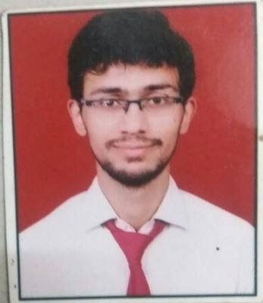
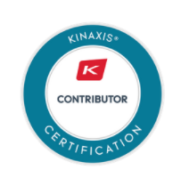
Ayush Trivedi
Kinaxis Consultant
RELEVANT WORK EXPERIENCE
Previous Experience:
Tata consultancy services: Java developer
Handling java development including design and troubleshooting of application, conducting gap analysis including validation of needs in conjunction with onsite and offsite teams
Monitoring Service based product progress and outstanding issues and ensuring the quality and timelessness of deliverables, also extending post implementation support to team members by identifying defects, inconsistencies and errors.
Working with onsite clients to track status and issues in offshore development mode, conducting reviews of codes and test cases and analyzing change requests/enhancements..
Working on ETL framework for creation of process and reports over semantic data using Statistics and Tableau.
Completing product development as per requirements, schedules and activities, contributing to team meetings, handling troubleshooting development and production issues across multiple environments.
Detailed analysis of process requirements from customer, future process requirement and solutions requirement of customer
.
SUMMARY
3 years of commendable experience in Java Development, Product Development, ETL Framework and Project Management .
Strong understanding of core java, algorithms, and data structures
Good Functional Knowledge of Kinaxis's Rapid response Application.
FUNCTIONAL EXPERIENCE
Development of supply constraints based demand allocation resources across manufacturing sites.
Creation of Worksheet/Workbooks, Scenarios, Collaboration, Filter and editing data in various Scenarios
INDUSTRY EXPERIENCE
IT
CERTIFICATIONS

